Slide 1
Children of Ruby
The different worlds of Elixir and Crystal
Simon St.Laurent
@simonstl
Content Manager, LinkedIn Learning

Slide 2
Where and who?

Slide 3
Where we are
Portland is in the land of Chinook peoples, including the Multnomah.
I wrote most of this along a former trail between the Cayuga and Onondaga territories of the Haudenosaunee.

Slide 4
Me: a meta-person
I only write “real code” occasionally, with my last big project in 2012.
I have spent lots of time in too many languages:
Usually this is confusing, but sometimes – like today! – it’s helpful.
ZX81 BASIC
Applesoft BASIC
Assembler
Spreadsheets
HyperCard
C
HTML
Asymetrix Toolbook
JavaScript
CSS
VBScript, VBA
XML, XSLT, X*
SQL
Java
Ruby
Erlang
Elixir
Crystal
Notes:
I’m also primarily a Web person.

Slide 5
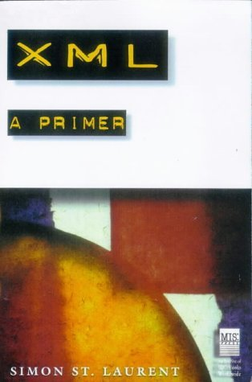
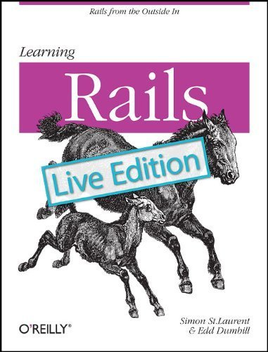
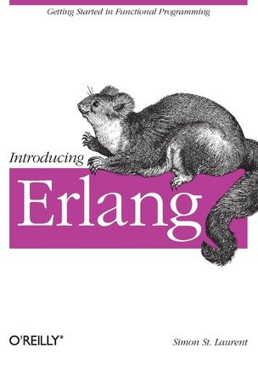
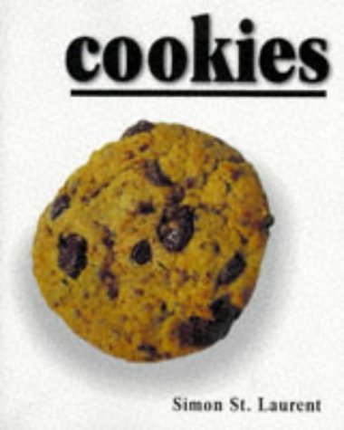
Educating (I hope)
Notes:
You should be suspicious of me for covering this much territory.

Slide 6
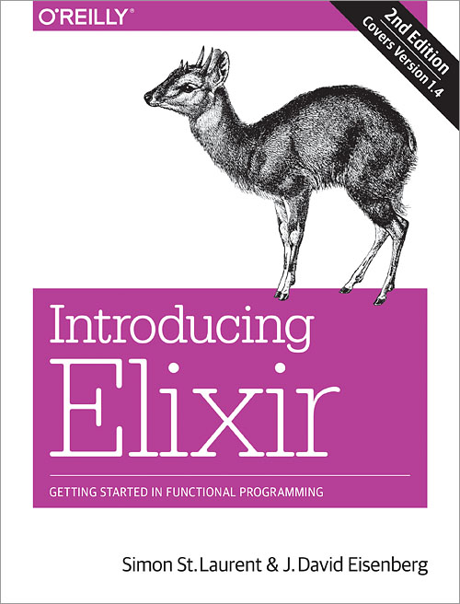
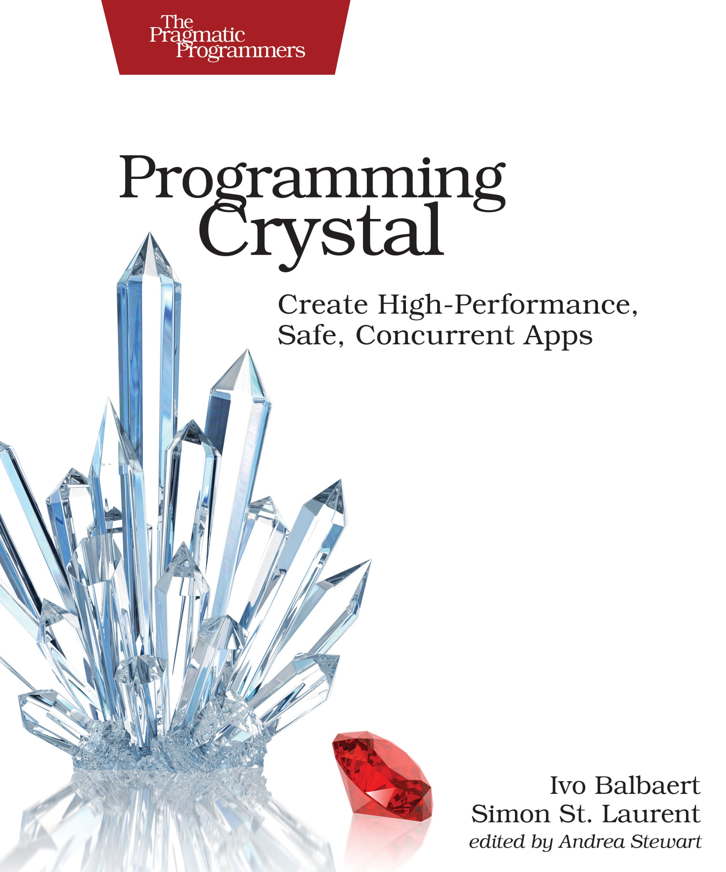
Most recently

Slide 7
Who else is here?
Notes:
Rubyists? People who have used Elixir? All the time? Crystal? All the time? Web-focused? Love dynamic languages? Like your types strong and static?

Slide 8
Ruby is amazing.

Slide 9
Ruby’s priorities
“I want to make Ruby users free. I want to give them the freedom to choose.”
– Matz, at https://www.artima.com/intv/ruby3.html
“Ruby is designed to make programmers happy.”
– Matz, in The Ruby Programming Language.

Slide 10
Ruby achieved its mission
“I initially fell in love with Ruby because other people’s code was just easier to read than anything else I’d previously encountered. You needed to learn what how blocks work and what |foo| means, then it all just fell into place. Then when, based on that, you figured out Enumerable, you might have had heart palpitations.”
Tim Bray
(https://www.tbray.org/ongoing/When/201x/2019/06/12/Go-Creeping-In)
But note the title of that piece “Go Creeping In.”

Slide 11
Why fork?

Slide 12
The Quiet Forks of 2011-2
No one noticed at the time.
Rails applications had pushed performance and reliability.
“Idiomatic Ruby” had mostly stabilized.
Ruby had avoided the Python 2.x to 3.x drama.

Slide 13
Why Elixir?
“I was doing a lot of work with Ruby, and making Rails thread-safe. That was my personal pain point, my personal war. I knew the shift was coming along, we wanted to use all the cores on my machine... it took us too long to make it thread-safe, literally years...
My original reaction was "there must be a solution to this problem." Once you go, it's hard to come back. The things that those languages, Clojure and Erlang, give you...”
José Valim, May 2016.
https://soundcloud.com/oreilly-radar/jose-valim-interviewed-by-simon-st-laurent

Slide 14
Why Crystal?
“Fast as C, slick as Ruby.”
“Crystal doesn’t allow you to have null pointer exceptions.”
Compilation (with LLVM) yields safety and performance.
Developer happiness and productivity as primary goals.
Notes:
while porting the Crystal parser from Ruby to Crystal, Crystal refused to compile because of a possible null pointer exception. And it was correct. So in a way, Crystal found a bug in itself :-)

Slide 15
Two newcomers
José Valim started Elixir in 2012.
Project supported by Platformatec and a growing community.
Ary Borenszweig, Juan Wajnerman, and Brian Cardiff started Crystal in 2011.
Project supported by Manas Technology Solutions and a growing community.
https://elixir-lang.org/
https://crystal-lang.org/

Slide 16
Current status
1.0 released in 2014
1.9 released this month
Self-hosting in 2013, first official release in 2014.
0.29.0 released in June.
Notes:
1.10 next for Elixir, point releases roughly every six months.

Slide 17
What’s next
“As mentioned earlier, releases was the last planned feature for Elixir. We don’t have any major user-facing feature in the works nor planned.”
Major projects yet to come:
Complete concurrency
Windows support.

Slide 18
Show me the code?

Slide 19
Elixir tries to be friendlier Erlang
Erlang
Elixir
-module(count).
-export([countdown/1]).
countdown(From) when From > 0 ->
io:format("~w!~n", [From]),
countdown(From-1);
countdown(From) ->
io:format("blastoff!~n").
defmodule Count do
def countdown(from) when from > 0 do
IO.inspect(from)
countdown(from-1)
end
def countdown(from) do
IO.puts("blastoff!")
end
end

Slide 20
Crystal tries to be friendlier C
C (header file elsewhere!)
Crystal
#include <stdio.h>
void countdown(int count) {
for (int i = count; i > 0; i--) {
printf("%d\n",i);
}
printf("Blastoff! \n");
}
void main() {
countdown(5);
}
def countdown (count)
while (count) > 0
puts count
count -= 1
end
puts("Blastoff!")
end
puts countdown(5)

Slide 21
Sometimes all three can (almost) line up
Ruby
Crystal
Elixir
def fall_velocity(planemo, distance)
gravity = case planemo
when :earth then 9.8
when :moon then 1.6
when :mars
3.71
end
velocity = Math.sqrt(2 * gravity * distance)
if
velocity == 0 then "stable“
elsif velocity < 5 then "slow“
elsif velocity >= 5 and velocity < 10
"moving“
elsif velocity >= 10 and velocity < 20
"fast“
elsif velocity >= 20
"speedy“
end
end
def fall_velocity(planemo : Symbol, distance : Int32)
gravity = case planemo
when :earth then 9.8
when :moon then 1.6
when :mars then 3.71
else 0
end
velocity = Math.sqrt(2 * gravity * distance)
if
velocity == 0
"stable"
elsif velocity < 5
"slow"
elsif velocity >= 5 && velocity < 10
"moving"
elsif velocity >= 10 && velocity < 20
"fast"
elsif velocity >= 20
"speedy"
end
end
def fall_velocity(planemo, distance) when distance >= 0 do
gravity = case planemo do
:earth -> 9.8
:moon -> 1.6
:mars -> 3.71
end
velocity = :math.sqrt(2 * gravity * distance)
cond do
velocity == 0 -> "stable"
velocity < 5 -> "slow"
velocity >= 5 and velocity < 10 -> "moving"
velocity >= 10 and velocity < 20 -> "fast"
velocity >= 20 -> "speedy"
end
end
Notes:
All three languages are generally readable by someone who knows any one of them.

Slide 22
What changed?

Slide 23
Both of these children
Add an explicit compilation step.
BEAM for Elixir
LLVM for Crystal.
Trim Ruby syntax to a smaller set, with fewer choices.
Have Ruby-like ecosystems, with parallel tools for Rails, Sinatra, testing frameworks, and more.
Retain Ruby’s emphasis on programmer fun and productivity.
Notes:
MINASWAN continues in both places.
Also, like Ruby, origins outside the US and Europe – both have Latin American roots.
gems, shards, hex
Rails / Amber / Phoenix

Slide 24
Types are the same but different
Ruby
Elixir
Crystal
Numbers
Boolean
Strings
Hashes
Arrays
Symbols
Closures
Ranges
Objects
integer
floats
booleans
strings
maps
lists
tuples
atoms
anonymous functions
port
Reference
PID
Integers (8-64, signed & unsigned)
Floats (32 or 64)
Bool
String
Char
Hash
Array
Tuple
NamedTuple
Symbol
Proc
Range
Object
Regex
Command (runs in a subshell)
Nil
Notes:
Elixir supports tools for additional type annotations.
Crystal’s list is abbreviated by not giving all the Int and Float types their own lines.

Slide 25
Ruby and Crystal and OOP
“Classical” inheritance-based object approaches.
A megadose of additional flexibility.
“Everything is an object.” (Almost.)
Everything has methods and properties directly available.
Notes:
Both languages have monkey patching, but Crystal uses method overloading rather than method shadowing.

Slide 26
Ruby and Crystal support functional
Ruby:
my_fn = ->(n, m) { n + m }
my_fn.call(4, 3) # => 7
Crystal:
my_fn = -> (n : Int32, m : Int32) { n + m }
my_fn.call(43, 108) # => 151
Notes:
Ruby has been a school for functional programming for decades, bridging object-oriented expectations with functional capabilities.
Crystal continues that tradition with a similar mix. These are the simplest approaches – you can also capture blocks, etc. Both Crystal and Ruby also support multiple mechanisms for defining lambdas and procs.
Crystal removes lambda vs. proc distinction
Neither, though, reliably supports tail call optimization.

Slide 27
Elixir is a more drastic shift
Yes:
my_fn = fn (n, m) -> n + m end
my_fn.(44, 108) # => 152
But: no objects, no methods, no properties. (Yes, modules.)
Everything that does something is a function.
Notes:
Note guards and pattern matching as superpowered function signatures.
Ruby syntax makes Erlang message-passing foundations more digestible.

Slide 28
Elixir’s pipe operator
Drop.fall_velocity(meters) |> Convert.mps_to_mph
Elixir added this syntax sugar early.
Ruby 2.7 added something like it, but… tricky
Crystal: “Adding Elixir's pipe operator (|>): in OOP languages we have methods and self. See #1388…. Please don't insist on these things because they will never, ever happen.”
Notes:
Pipes only apply to the first argument of a function, so you’ll need to structure your functions to play nicely with pipes if you want to use this extensively.

Slide 29
Messaging models
Sending messages is more flexible than calling functions.
Elixir processes communicate by sending messages to each other at named endpoints. OTP cranks up that model.
Crystal uses (green) fibers with channels for communications between them, in a Communicating Sequential Processes model.
Difficult to compare, because Crystal isn’t done.
Notes:
Be grateful that none of these use shared memory, an especially common temptation in C-related languages. No locks, either!
CSP means that channels are set up between specific fibers rather than a general message-passing clearing house, and also requires receivers to be listening. Probably more solid in single system environments, but hard to share across nodes.

Slide 30
Macros and metaprogramming
Metaprogramming is a huge part of Ruby’s appeal.
Both Crystal and Elixir step away from method_missing.
Crystal still supports monkeypatching, adding new methods to classes and modules.
Both Crystal and Elixir offer macros, with warning labels.
Notes:
SO WHERE DOES THIS TAKE US?

Slide 31
What’s in it for me?

Slide 32
Elixir’s large promises
Dave Thomas: “Programming should be about transforming data.”
Processes (functions) grow and die lightly.
OTP supervisors, workers, and a distributed node model.
Phoenix layers on top of OTP, but feels like Rails.
Notes:
The biggest problem with OTP is that it sounds like impossible ridiculous magic when you describe it to someone who hasn’t worked with it before. “Open Telecom Platform whatever!” is a common response.
Give Nerves for IoT a shout-out.

Slide 33
Crystal’s large promises
Errors at compile time, not at runtime.
Compiler disciplines code while keeping it familiar.
Type inference protects you without cluttering code.
Compilation gives you the performance you always wanted.
Notes:
The biggest problem with OTP is that it sounds like impossible ridiculous magic when you describe it to someone who hasn’t worked with it before. “Open Telecom Platform whatever!” is a common response.

Slide 34
Resilience
Crystal
Elixir
Nil won’t break things
Types ensure reliability
Let it crash
OTP supervisors and workers
Update code on the fly

Slide 35
Performance
Crystal
Elixir
Tight compilation
Running close to the metal
Riding on LLVM
Parallel processing as normal
Lightweight functions
Riding on BEAM

Slide 36
So… which one?

Slide 37
Why choose Ruby?
Mega-metaprogramming
Vast libraries
Broad talent pool
Notes:
Or just because you like its mix of functional approach and practical deployability.

Slide 38
Why choose Elixir?
Parallelism
Distributed applications
Uptime
Notes:
Or just because you like its mix of functional approach and practical deployability.

Slide 39
Why choose Crystal?
Performance on complex tasks
Runtime reliability
Application packaging
Notes:
Also simple familiarity – doesn’t just look like Ruby, but mostly behaves like it.

Slide 40
Please Use It For Good
I’ll let you determine what “good” means, but think about it.
Please try to use Elixir and Crystal’s powers for projects that make the world a better place, or at least not a worse place.
Notes:
MINASWAN continues in both places.
Also, like Ruby, origins outside the US and Europe – both have Latin American roots.

Slide 41
Children of Ruby
The different worlds of Elixir and Crystal
Simon St.Laurent
@simonstl
Content Manager, LinkedIn Learning

